Slide 1


Certification Training Session

Slide 2
Exam Objectives
Understand Cloud Concepts
Understand Core Azure Services
Understand Security, Privacy, Compliance, and Trust
Understand Azure Pricing and Support

Slide 3
Cloud Basics
Understand Cloud Services
Understand Key Terms
Understand Cloud Models
Understand Economies of Scale
Understand Cloud Services

Slide 4


Slide 5
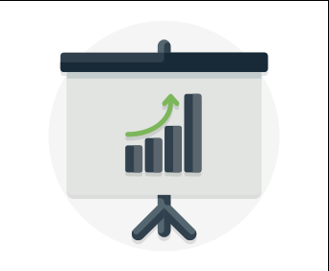
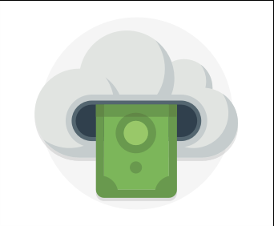


Key Concepts & Terms
Agility
Scalability
Elasticity
Global Reach
Cost
Economies of Scale
Predictive Planning
Availability
Fault Tolerance
Disaster Recovery
Security
Intelligence
Threat Detection
Reporting

Slide 6
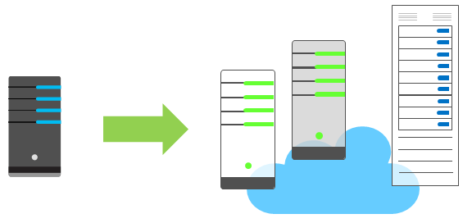
Economies of Scale
Economies of scale are apparent to end users in a number of ways, one of which is the ability to acquire hardware at a lower cost than if a single user or smaller business were purchasing it.
Storage costs, for example, have decreased significantly over the last decade due in part to a cloud providers' ability to purchase larger amounts of storage at significant discounts.

Slide 7
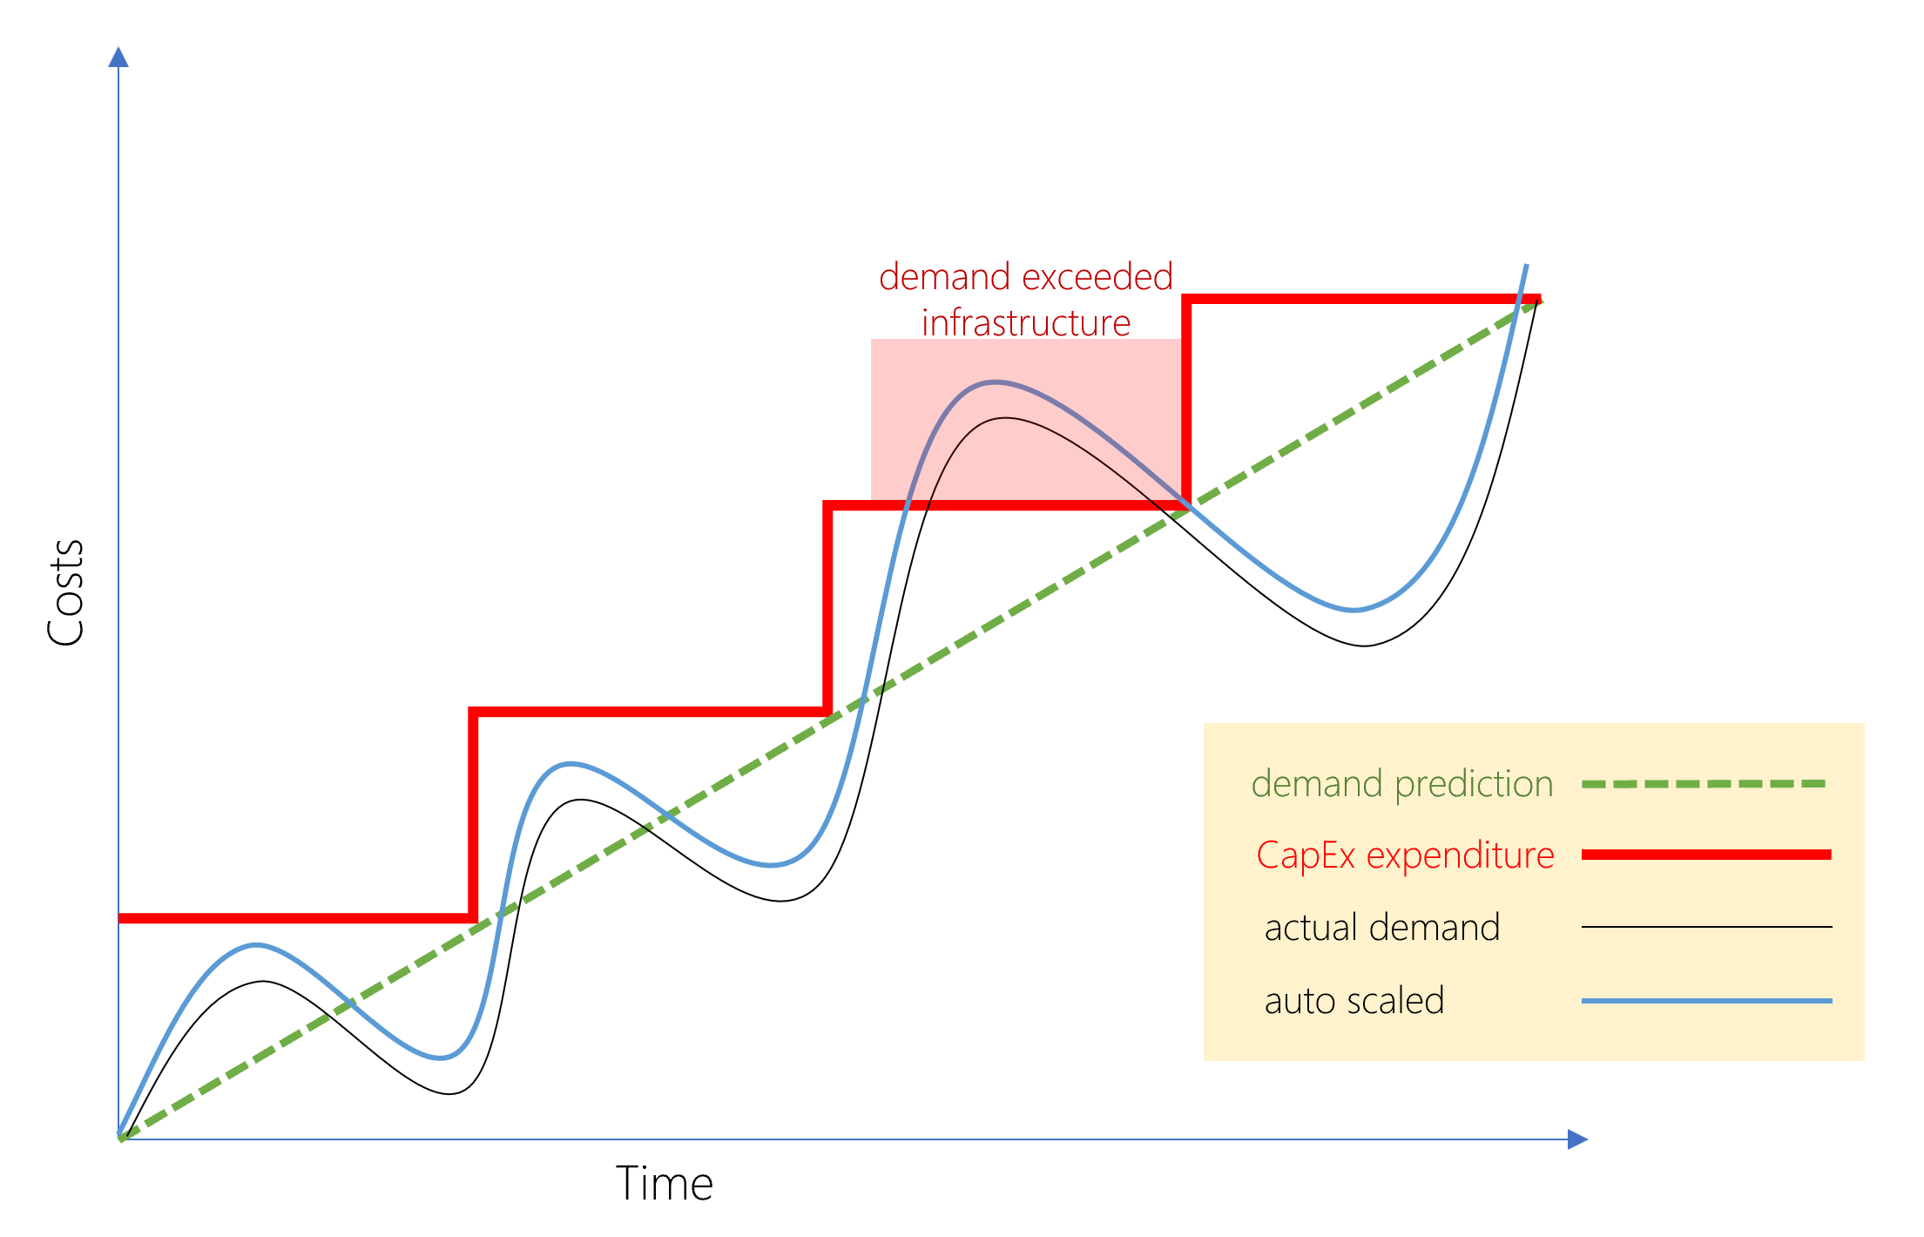
CapEx vs OpEx
Today, organizations can sign up for a service from a cloud provider to get up and running. This enables them to begin selling or providing services to their customers more quickly, without the need for significant upfront costs
If your service is busy and you consume a lot of resources in a month, then you receive a large bill. If those services are minimal and don't use a lot of resources, then you will receive a smaller bill.
A business can still use the CapEx expenditure strategy if they want, but it is no longer a requirement that they do so.
Demand and growth can be unpredictable and can outpace expectation, which is a challenge for the CapEx model as shown in the following graph.

Slide 8

Public Cloud Models
Public Cloud Models have the following characteristics:
Multiple end users - Public cloud providers make resources available to multiple organizations.
Availability – Public clouds are the most common cloud deployment model.
Connectivity - Users and organizations are typically connected to public clouds over the internet.
Skills - Public clouds do not require deep technical knowledge to set up and use
Businesses can use multiple public cloud service providers. Microsoft Azure is an example of a public cloud provider.

Slide 9
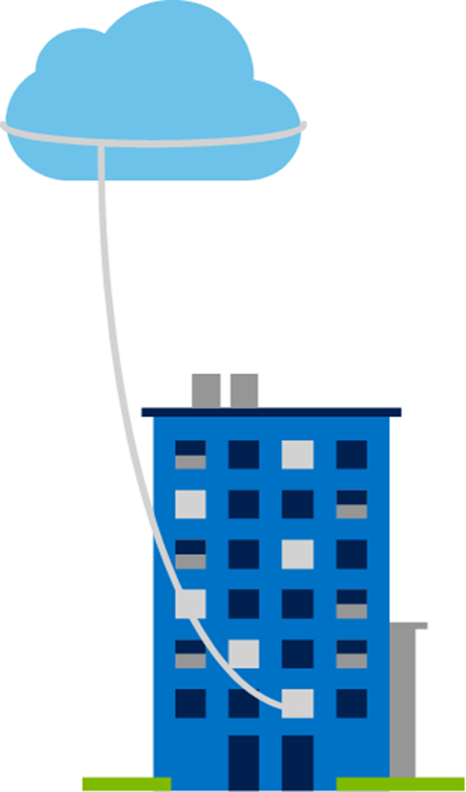
Private Cloud Models
Private Cloud Models have the following characteristics:
Hardware - The organization is entirely responsible for the purchase, maintenance, and management of the hardware.
Users - Private cloud computing resources are used exclusively by a single organization.
Connectivity - A connection is typically made over a private network that is highly secure.
Public access - A private cloud does not provide access to the public.
Skills - Deep technical knowledge is required to set up, manage, and maintain the private cloud.

Slide 10
Hybrid Cloud Models
Hybrid Cloud Models have the following characteristics:
Resource location - Specific resources are used in a public cloud, others are used in a private cloud.
Cost and efficiency - Hybrid cloud models allow an organization to leverage some of the benefits of cost, efficiency, and scale that are available with a public cloud model.
Control - Organizations retain management control in private clouds.
Skills - Technical skills are required to maintain the private cloud and ensure both cloud models can operate together.
Hybrid cloud scenarios can be useful when organizations have some information that cannot be put in a public cloud, possibly for legal reasons. For example, you may have medical data that cannot be exposed publicly.

Slide 11
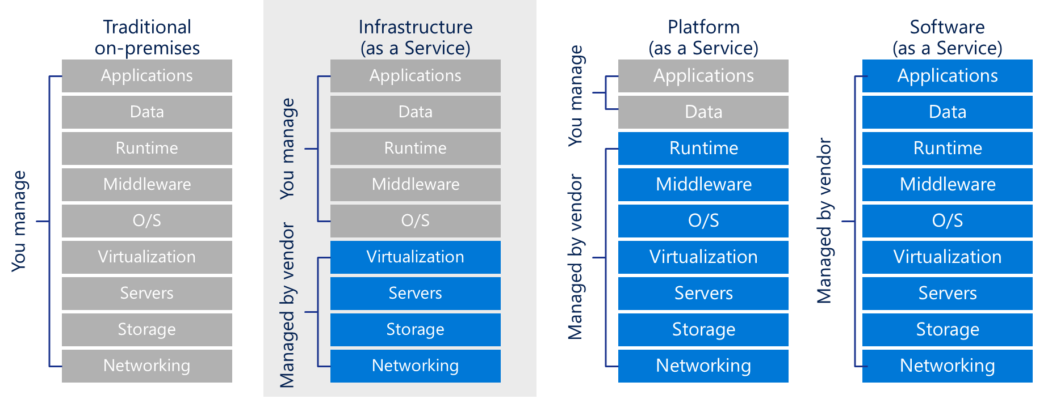

Cloud Service Comparison
There is a shared responsibility model for ensuring cloud workloads are run securely and in a well-managed way. Depending on the service you are using, the cloud provider is responsible for some aspects of the workload, leaving the customer responsible for the remaining aspects of the workload.

Slide 12
Azure Core Services
Understand core Azure architectural components
Understand core Azure services and products
Understand Azure solutions
Understand Azure management tools

Slide 13
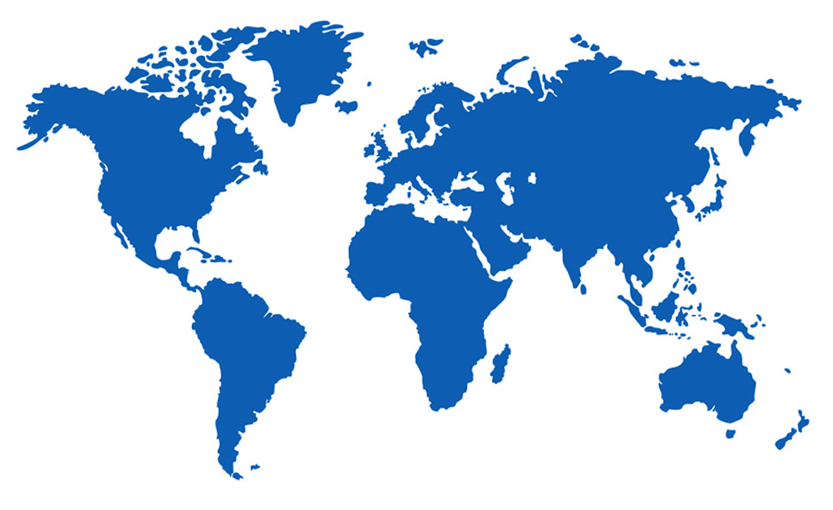
Regions
Azure is made up of datacenters located around the globe. These datacenters are organized and made available to end users by country/region
In reference to datacenters, a region is a geographical area on the planet containing at least one, but potentially multiple datacenters that are in close proximity and networked together with a low-latency network
Each region is paired with another within the same geography (such as US, Europe, or Asia). This approach allows for the replication of resources and helps reduce the likelihood of interruptions due to events such as natural disasters, power outages, or physical network outages.

Slide 14
Geographies
A geography is a discrete market typically containing two or more regions that preserves data residency and compliance boundaries
Geographies allow customers with specific data-residency and compliance needs to keep their data and applications close
Geographies are broken up into Americas, Europe, Asia Pacific, Middle East, and Africa

Slide 15
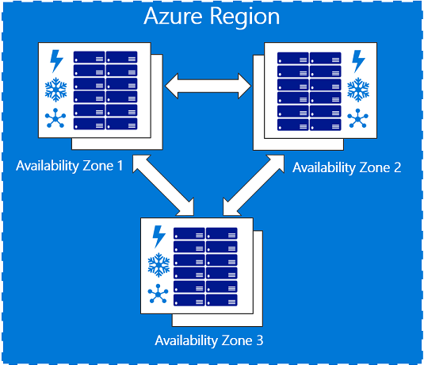
Availability Zones
Availability zones are physically separate locations within an Azure region.
Each availability zone is made up of one or more datacenters equipped with independent power, cooling, and networking.
Availability Zones are set up to be an isolation boundary.
If one availability zone goes down, the other continues working.

Slide 16
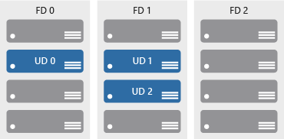
Availability Sets
Availability sets comprise of update and fault domains:
Update domains. When a maintenance event occurs (such as a performance update or critical security patch applied), the update is sequenced through update domains.
Fault domains. Fault domains provide for the physical separation of a workload across different hardware in the datacenter.
Availability sets help ensure applications remain online during maintenance events, or hardware failure.

Slide 17
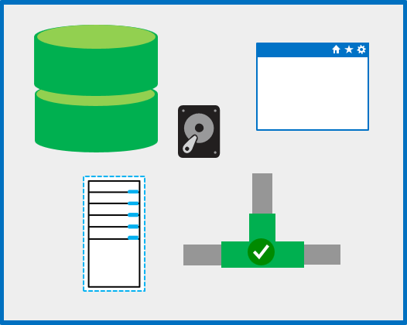
Resource Groups
A resource group is a unit of management, similar to a container that allows you to aggregate and manage all resources required for an application to run within a single manageable unit
Resource groups allow you to control costs, set automation and set policy against resources

Slide 18
Resource Manager
Azure Resource Manager is a management layer in which resource groups and all the resources within it are created, configured, managed, and deleted.
With Azure Resource Manager, you can:
Deploy application resources
Organize resources
Control access and resources
Azure Resource Manager, provides a consistent management layer that allows you to automate deployment and configuration of resources using different automation and scripting tools, such as Azure PowerShell, Azure Command-Line Interface, Azure portal, REST API, and client software development kits (SDKs).

Slide 19
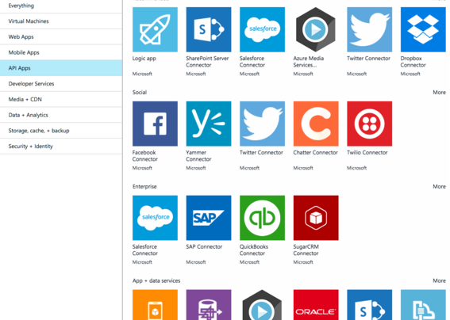
Azure Marketplace
Azure Marketplace is a service on Azure that helps connect end users with Microsoft partners, independent software vendors (ISVs), and start-ups that are offering their solutions and services, which are optimized to run on Azure
Azure Marketplace allows customers mostly IT professionals and cloud developers to find, try, purchase, and provision applications and services from hundreds of leading service providers, all certified to run on Azure.

Slide 20

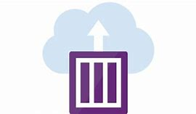
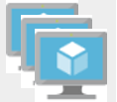
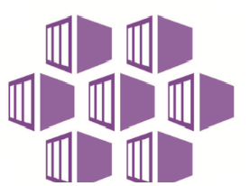


Azure Compute
Examples of Azure services for virtual machines include:
Azure VMs. Infrastructure as a service (IaaS) used to create VMs in the cloud
VM scale sets. Designed for automatic scaling of identical VMs
App services. platform as a service (PaaS) offerings to build, deploy, and scale enterprise-grade web, mobile, and API apps
Functions. Creates infrastructure based on an event
Examples of Azure services for containers include:
Azure Container Instances. A PaaS offering that allows you to upload your containers, which it then will run for you
Azure Kubernetes Service. A container orchestrator service for managing large numbers of containers

Slide 21





Azure Networking
Networking on Azure allows you to connect cloud and on-premises infrastructure and services.
Azure Virtual Network enables resources such as Azure VMs to securely communicate with each other, the internet, and on-premises networks.
Azure Load Balancer provides scale for your applications and high availability for your services
A VPN gateway sends encrypted traffic between an Azure Virtual Network and an on-premises location over the public internet.
Azure Application Gateway is a web traffic load balancer and the connection through which users connect to your application.
A content delivery network (CDN) is a distributed network of servers that get content to users in their local region to minimize latency.

Slide 22



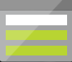
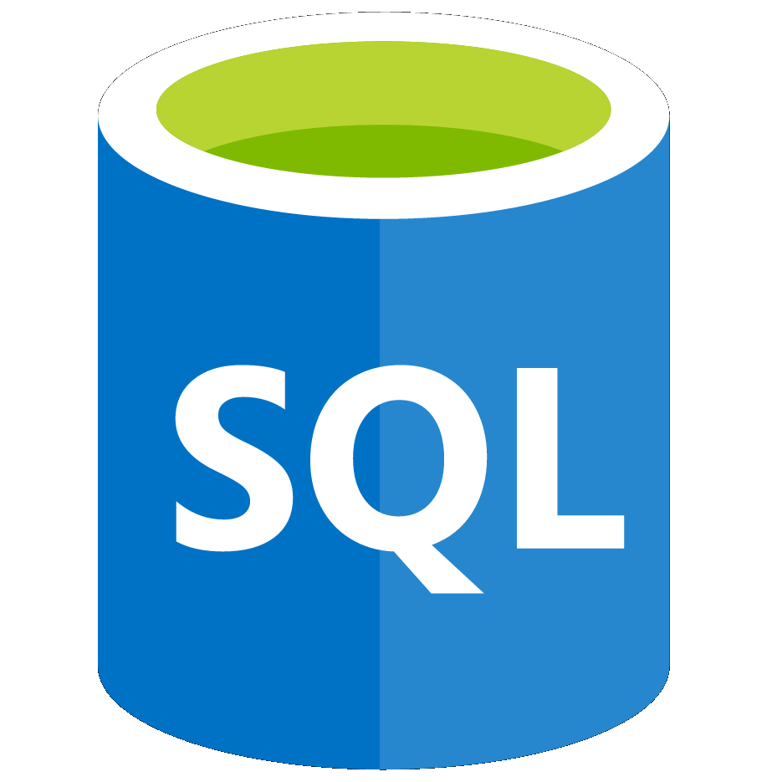

Azure Data Services
Azure Storage is a service that you can use to store files, messages, tables, and other types of information.
Blob storage. No restrictions on the kinds of data it can hold. Blobs are highly scalable
Disk storage. Provides disks for virtual machines, applications, and other services
File storage. Azure Files offers fully-managed file shares in the cloud
Archive storage. Storage facility for data that is rarely accessed
Azure database services are fully-managed PaaS database services that free up valuable time you’d otherwise spend managing your database
Azure Cosmos DB. A globally-distributed database service that enables you to elastically and independently scale throughput and storage
Azure SQL Database. A relational database as a service (DaaS) based on the latest stable version of the Microsoft SQL Server database engine

Slide 23
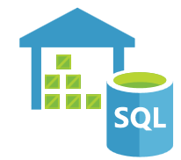



Big Data & Analytics
Big data refers to large volumes of data that become increasingly hard to make sense of, or consequently make decisions about. Some big data and analytic services in Azure include:
Azure SQL Data Warehouse leverages massively parallel processing (MPP) to run complex queries quickly across petabytes of data.
Azure HDInsight makes it easier, faster, and more cost-effective to process massive amounts of data and runs popular open-source frameworks such as Spark, Hadoop and Storm.
Azure Data Lake Analytics simplifies big data. Instead of deploying, configuring, and tuning hardware, you write queries to transform your data and extract valuable insights.
Azure Databricks is a Spark based analytics platform optimized for Azure and provides one-click setup, streamlined workflows, and an interactive workspaces that enable collaboration between data scientists, data engineers, and business analysts.

Slide 24


Internet of Things
The ability for devices to gather and then relay information for data analysis is referred to as the Internet of Things (IoT)
Microsoft IoT Central is a fully managed global Internet of Things (IoT) solution that makes it easy to connect, monitor, and manage your IoT assets at scale.
Azure IoT Hub is a managed service that acts as a central message hub for bi-directional communication between your IoT application and the devices it manages.

Slide 25


Artificial Intelligence
Artificial Intelligence (AI), in the context of cloud computing, is based around a broad range of services, the core of which is machine learning. Machine learning is a data science technique that allows computers to use existing data to forecast future behaviours, outcomes, and trends.
Using machine learning, computers learn without being explicitly programmed.
Some AI services in Azure include:
Azure Machine Learning service. Provides a cloud-based environment used to develop, train, test, deploy, manage, and track machine learning models
Azure Machine Learning Studio. A collaborative, drag-and-drop visual workspace where you can build, test, and deploy machine learning solutions without needing to write code

Slide 26





Cognitive Services
Cognitive services are a collection of domain-specific pre-trained AI models that can be customized with your data. They are categorized broadly into vision, speech, language, and search.
Vision makes it possible for apps and services to accurately identify and analyse content within images and videos.
Speech services can convert spoken language into text, or produce natural-sounding speech from text using standard (or customizable) voice fonts.
Language services can understand the meaning of unstructured text or recognize the speaker’s intent.
Harness the power of a web-scale, ad-free search engine. Find information across billions of web pages, images, videos, and news search results.
Knowledge services create rich knowledge resources that integrate into apps and services.

Slide 27
Serverless Computing
Serverless computing is a cloud-hosted execution environment that runs your code but abstracts the underlying hosting environment.
Some serverless services in Azure include:
Azure Functions are ideal when you're only concerned with the code running your service and not the underlying platform or infrastructure and commonly used when you need to perform work in response to an event.
Azure Logic Apps help you automate and orchestrate tasks, business processes, and workflows when you need to integrate apps, data, systems, and services across enterprises or organizations.
Azure Event Grid allows you to easily build applications with event-based architectures. It's a fully-managed, intelligent event routing service that uses a publish-subscribe model for uniform event consumption.

Slide 28
Azure Pricing and Support
Subscriptions and Management groups
Plan and manage Azure costs
Identify Azure support options
Understand Azure Service Level Agreements
Understand the service lifecycle in Azure

Slide 29
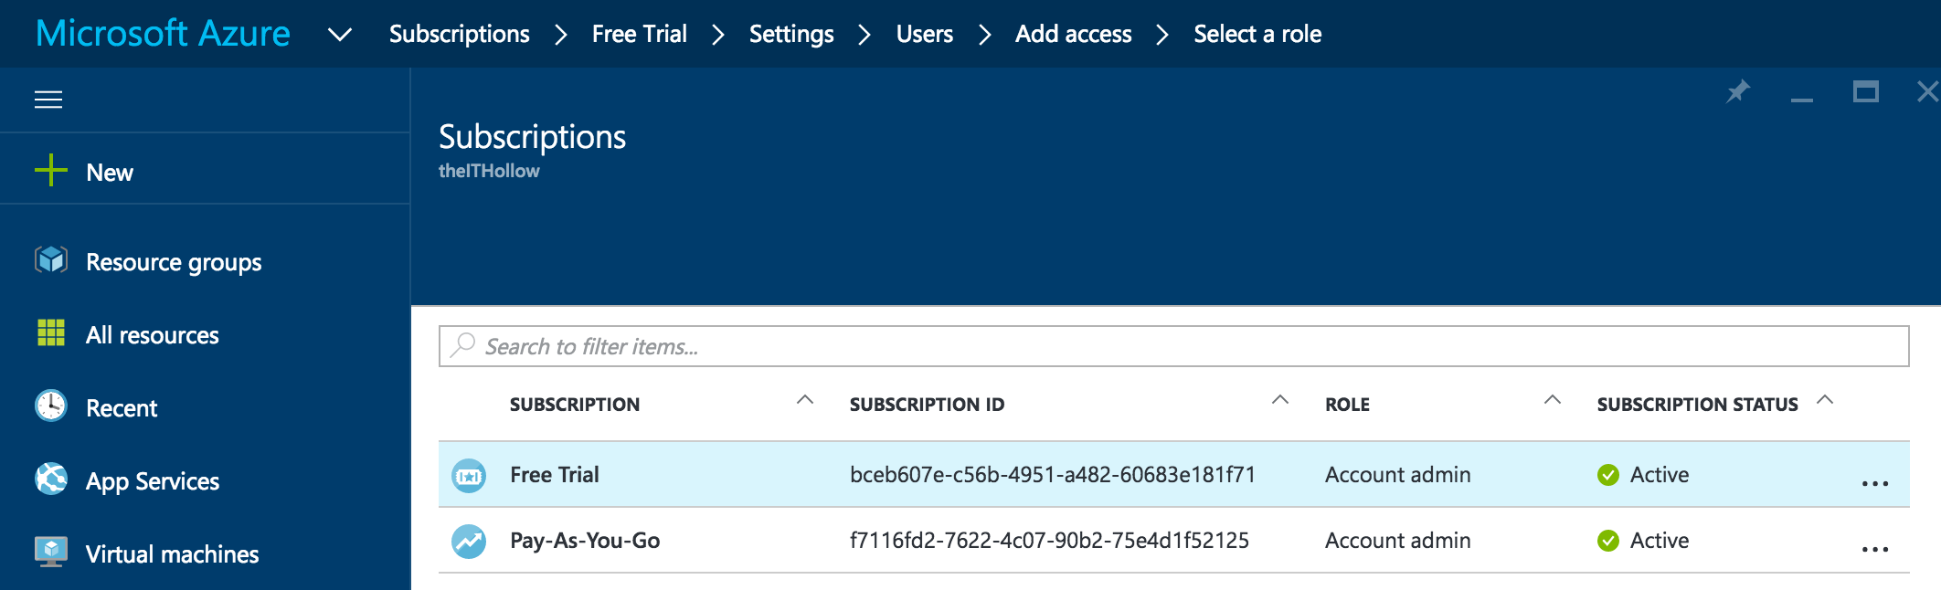
Azure Subscriptions
An Azure subscription provides you with authenticated and authorized access to Azure products and services. It is a logical unit that links to an Azure account.
Azure offers free and paid subscription options to suit different needs and requirements. An account can have one subscription or multiple subscriptions that have different billing models, and to which you apply different access-management policies.
You can use Azure subscriptions to define boundaries around Azure products, services, and resources. This includes:
Billing boundary which determines how an Azure account is billed for using Azure.
Access control boundary which applies access management policies at the subscription level.

Slide 30
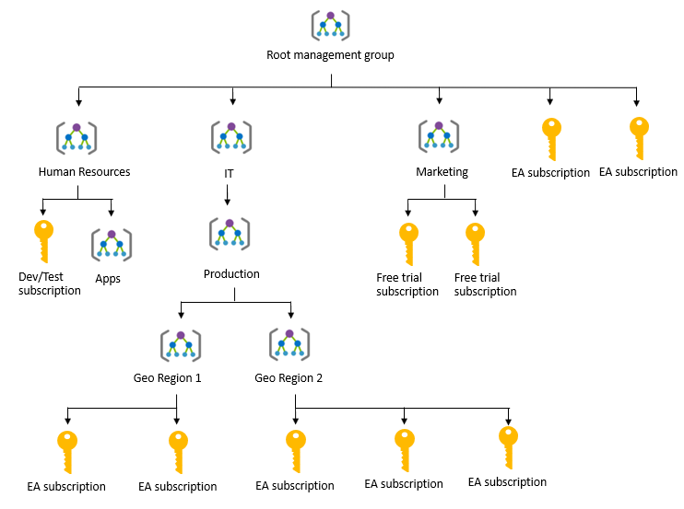
Management Groups
Azure Management groups are containers for managing access, policies, and compliance across multiple Azure subscriptions.
Management groups allow you to order your Azure resources hierarchically into collections, which provide a further level of classification beyond subscriptions.

Slide 31
Zones
A zone is a geographical grouping of Azure Regions for billing purposes:
Zone 1. Includes West US, East US, West Europe, and others.
Zone 2 . Includes Australia Central, Japan West, Central India, and others.
Zone 3. Includes Brazil South only.
DE Zone 1. Includes Germany Central and Germany Northeast.

Slide 32
Purchasing Options
Enterprise customers commit to spending a negotiated amount on Azure services, which they typically pay annually.
Web direct customers sign up through the Azure website.
Cloud solution providers are Microsoft partner companies that a customer hires to build solutions on top of Azure. Payment and billing for Azure usage occurs through the customer's CSP.
Three factors affect costs:
Resource Type: Costs are resource-specific, so the usage that a meter tracks and the number of meters associated with a resource depend on the resource type.
Services: Azure usage rates and billing periods can differ between Enterprise, Web Direct, and CSP customers.
Location: The Azure infrastructure is globally distributed, and usage costs might vary between locations that offer particular Azure products, services, and resources.

Slide 33
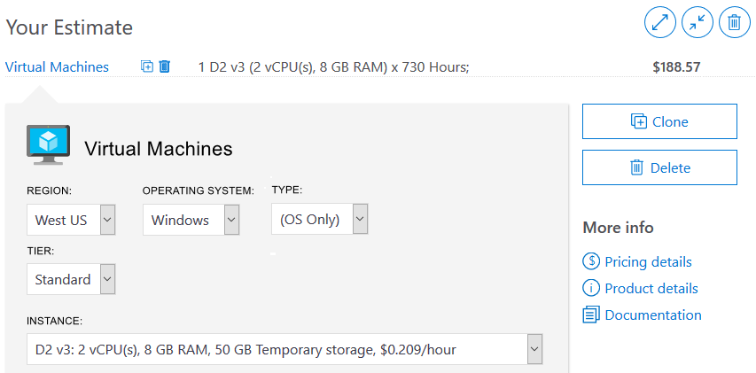
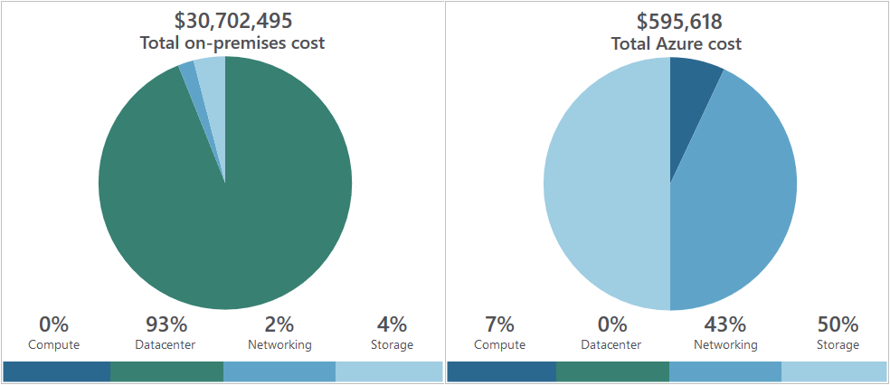
Purchasing Calculators
Azure Calculator
Helps you estimate the your needs and configure them according to your specific requirements
Azure provides a detailed estimate of the costs associated with your selections and configurations
TCO Calculator
Helps you estimate cost savings realized by migrating to Azure
Compares the costs of on-premises infrastructures with the costs of using Azure products and services to host infrastructure in the cloud

Slide 34
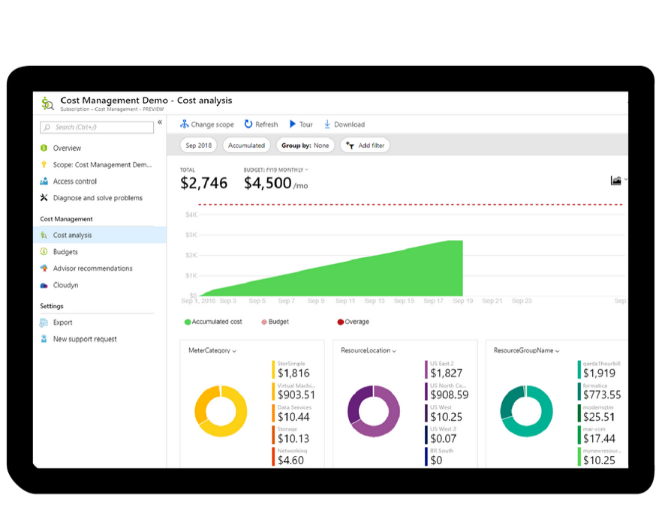
Azure Cost Management
Azure Cost Management provides a set of tools for monitoring, allocating, and optimizing Azure costs
Azure Cost Management Includes:
Reporting
Improved accountability with resource tags
Monitor resource demand trends, consumption rates, and cost patterns
Alerting based on cost and usage budgets
Recommendations to eliminate idle resources and to optimize provisioned Azure resources

